Slide 1
Elixir is better than C# and Java?

Slide 2
OVERVIEW
History
Language features
Platform features

Slide 3
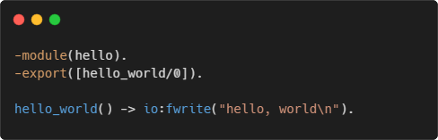
It all started with erlang
Developed in the 1980s by Ericsson
Runs on BEAM virtual machine
Suitable for telecoms
Distributed
Fault-tolerant
High-availability
Used by WhatsApp, RabbitMQ, Motorola

Slide 4
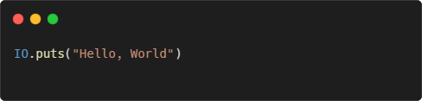
Enter elixir
Created in 2012 by Jose Valim
Runs on BEAM
Used by Discord, Pinterest, Spotify
Main features
Functional paradigm
Immutable data structures
Pattern matching
REPL and documentation as first-class citizen

Slide 5
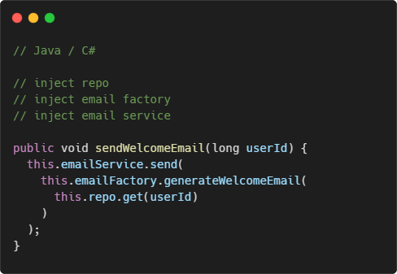
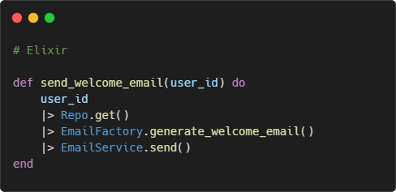
Functional programming
Focus on actions and business logic, not on objects and instances

Slide 6
The concept of OOP
The term is coined by Alan Kay (a biologist) in the 1960s
Simulating the cells in living organisms
Cells have isolated internal states (data)
Decoupled from each other
Communicate through messages

Slide 7
Where are the classes?
“If I could do Java over again, I would leave out classes.” – James Gosling
“OOP to me means only messaging, local retention and protection and hiding of state-process, and extreme late-binding of all things.” – Alan Kay
It’s about encapsulation and message passing

Slide 8
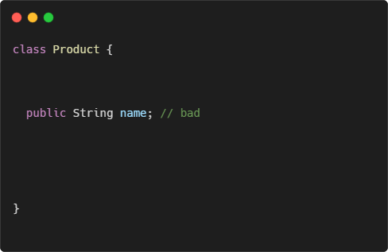
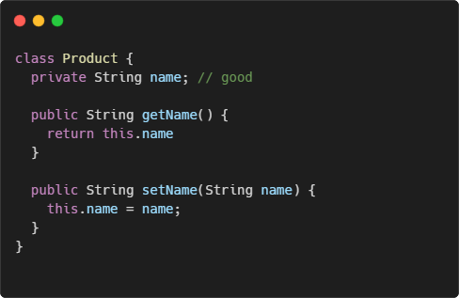
Let’s talk about encapsulation
What’s the difference?

Slide 9
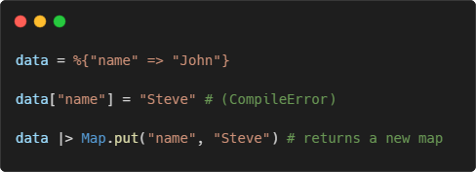
The real encapsulation
Avoiding shared mutable state
Reduce side effects
Less bugs
Forget about getters and setters
In Elixir, everything is immutable!
Records in Java/C# are a step in the right direction

Slide 10
Pattern matching
Popular in functional languages
Test whether the object matches a given expression
Cleaner control flow statements

Slide 11

Demo

Slide 12
REPL and doctests
Elixir has a built-in REPL (Read–eval–print loop)
Execute simple expressions
Start as part of the app
Attach to a running app
Doctests
Mix between unit tests and documentation
Keeps the documentation up to date

Slide 13
Demo

Slide 14
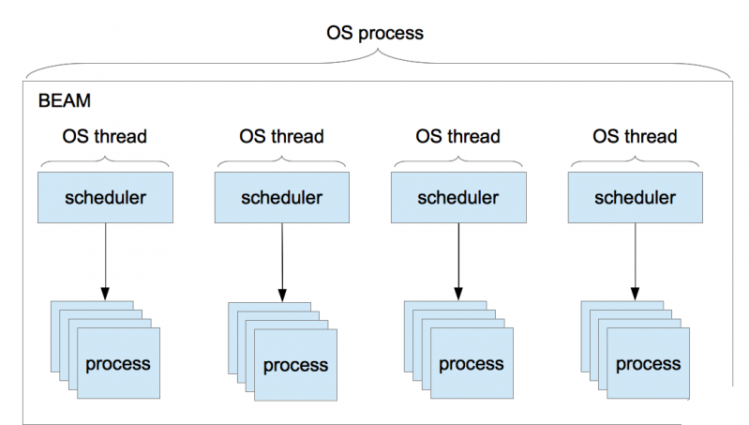
BEAM concurrency model
BEAM VM has its own scheduler
Runs lightweight processes
No shared state
Communication via message passing

Slide 15
Concurrency model benefits
Better performance (no locks)
Fault tolerance
Scalability – up to ~268M running processes

Slide 16
Performance examples
The Road to 2M WebSocket Connections
How Discord Scaled Elixir to 5,000,000 Concurrent Users
Processing 2.7 million images with Elixir
Presentation: github.com/georgiyolovski/elixir-tech-talk

Slide 17
Why chose Elixir?
Code clarity
Less bugs
Development experience
Performance

Slide 18
Thank you

